Slide 1
Intro to Confidential Computing Consortium

Slide 2
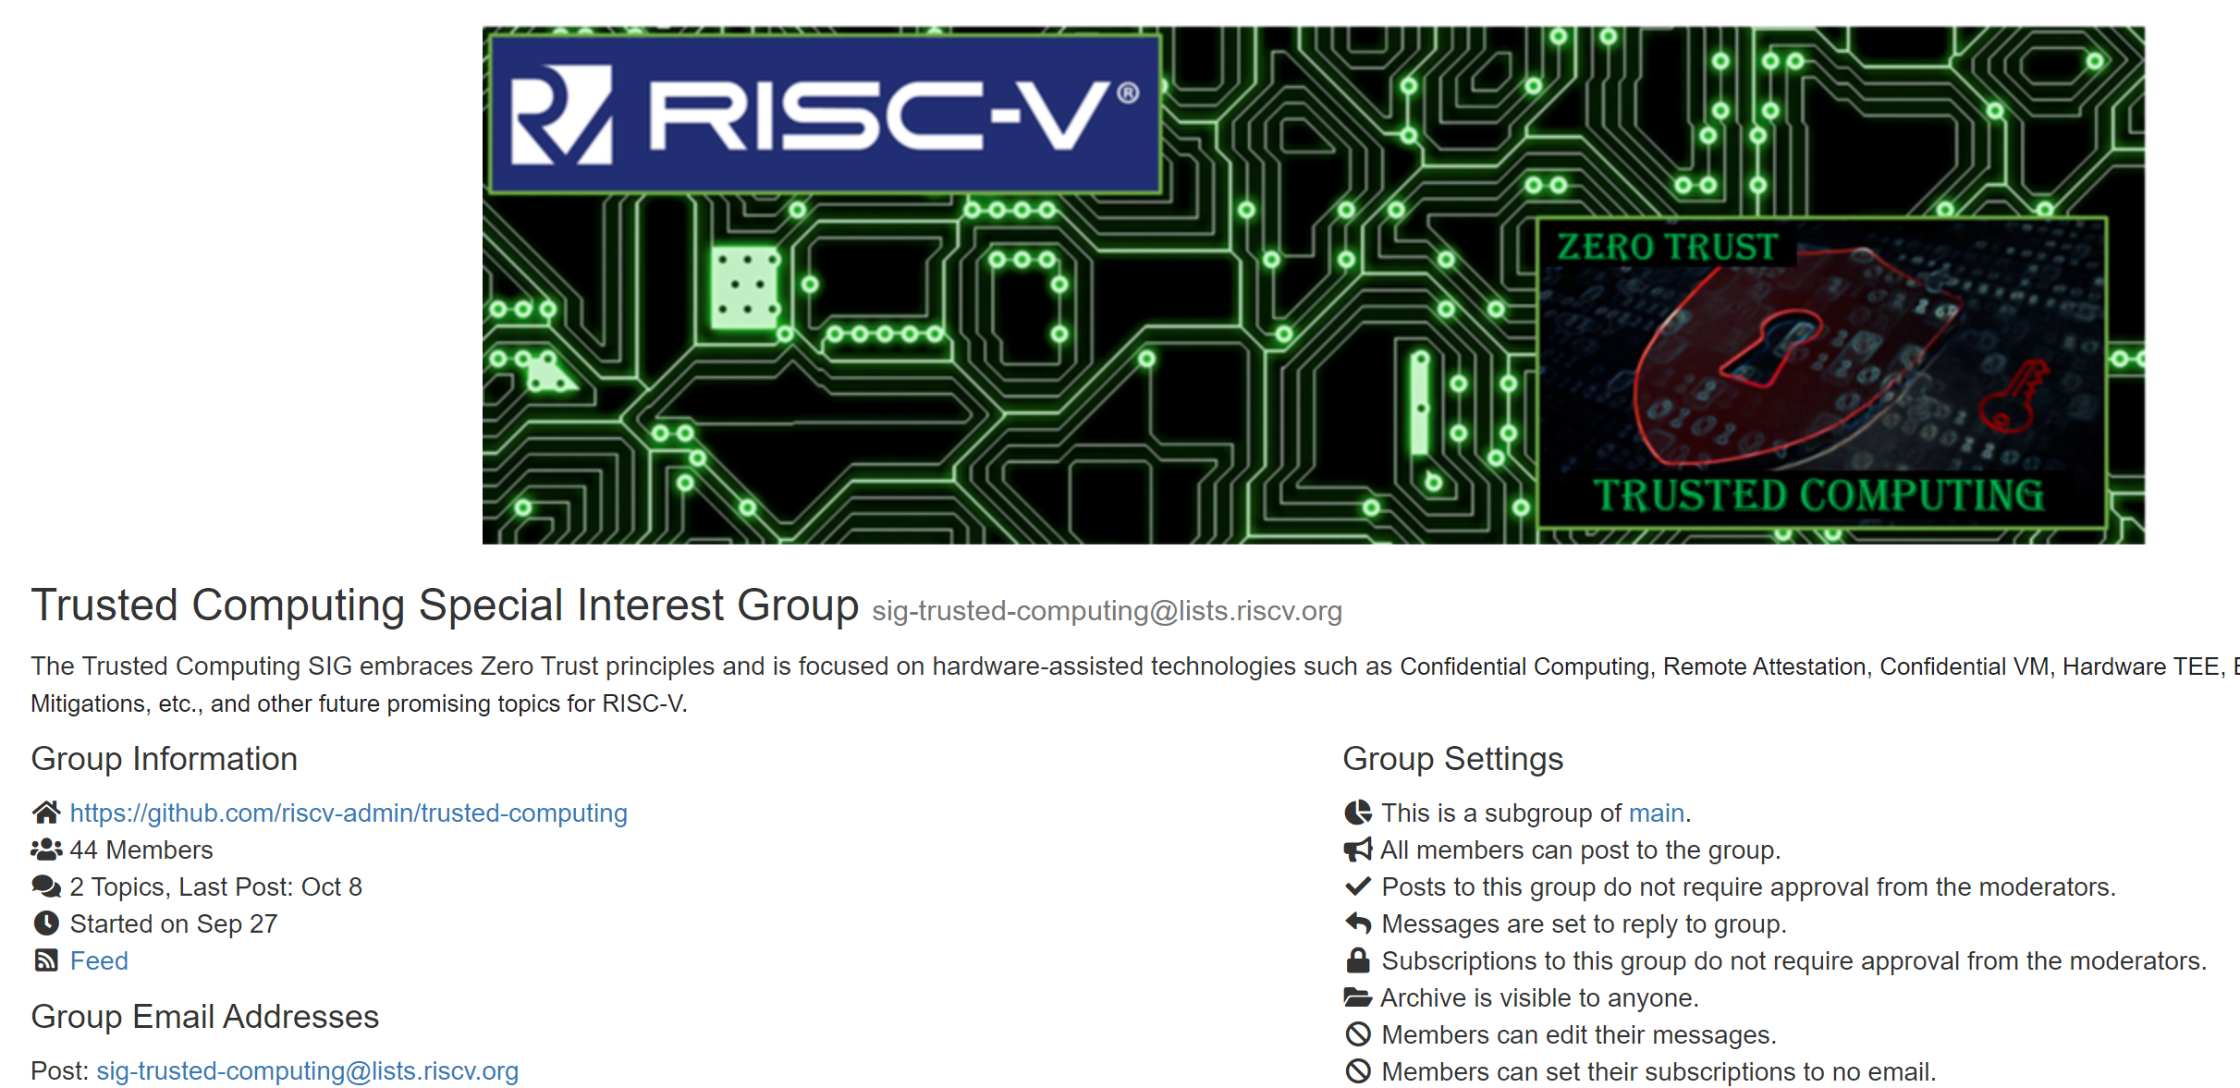
WHO ARE WE?

Slide 3
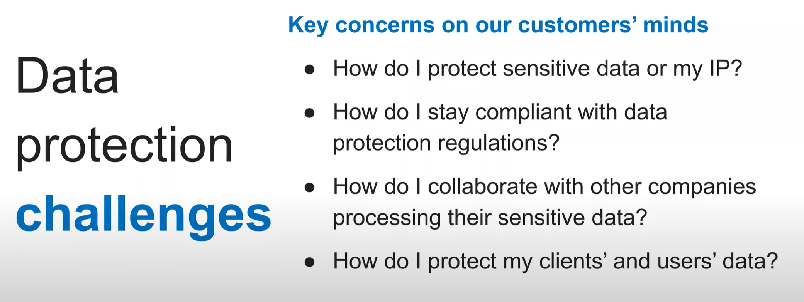
The challenge
https://confidentialcomputing.io/

Slide 4
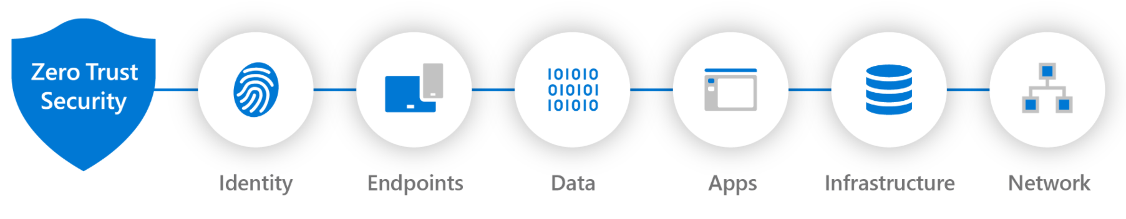
Zero Trust Security Architecture
Data at Rest and Transit are already protected, but data in use is also very key!!

Slide 5
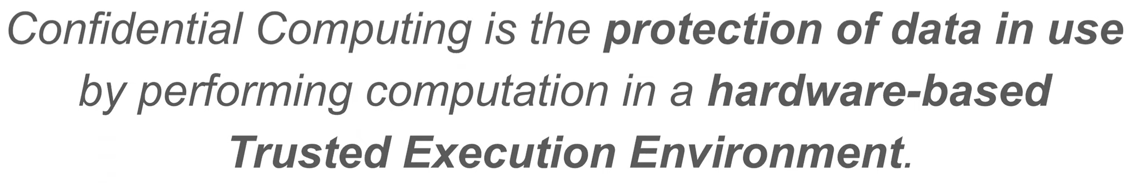
What is confidential computing?
https://confidentialcomputing.io/

Slide 6
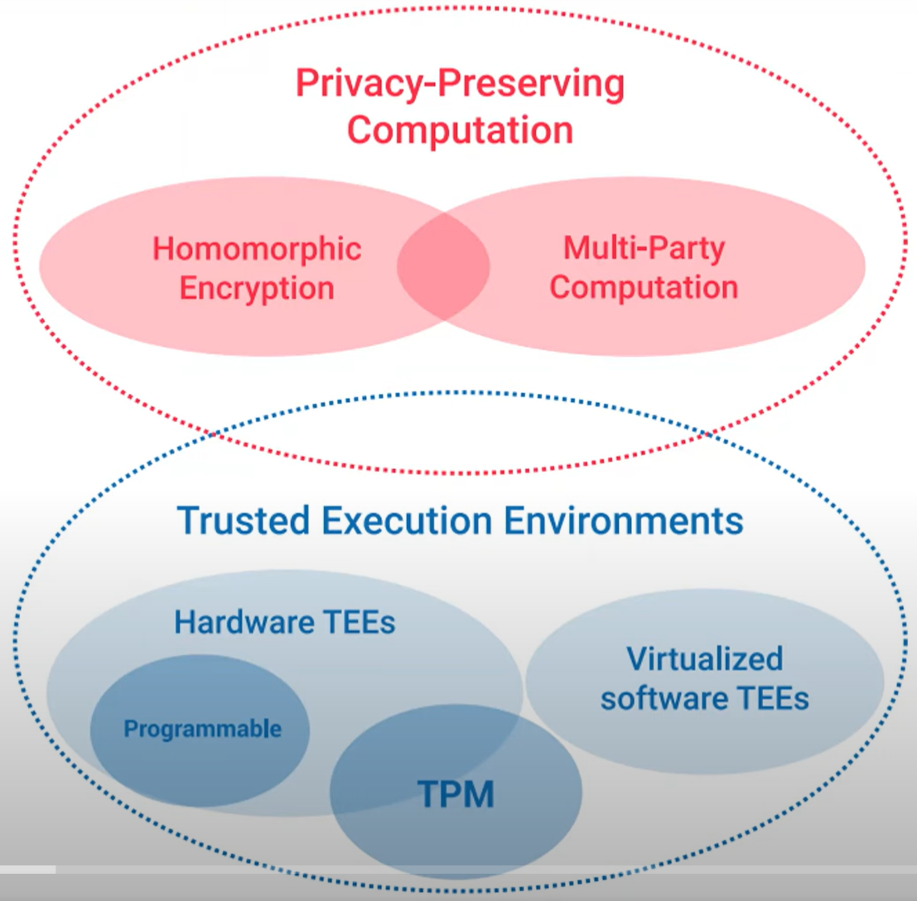
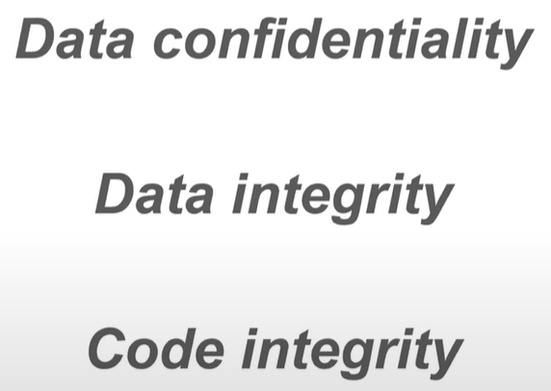
Protecting data in use
https://confidentialcomputing.io/
Remotely Attestable

Slide 7
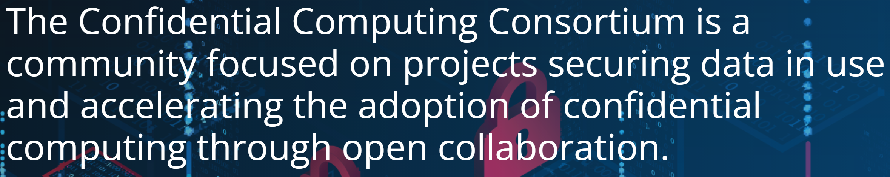

Risc-v & confidential computing Consortium
How best shall RISC-V.org collaborate with CCC.io?
We welcome Dave Thaler from CCC.io to give an overview today!!

Slide 8
Thank You

